Slide 1
Creating A Landing
Page Of A Binar Car Rental Site.Using Html, CSS & Javascript
By Lusi Pri Hartini

Slide 2
Media
Menggunakan
Teks editor (VS Code)
JavaScripts
Swipper.js
Web Browser
CSS
Iconscout
Github
HTML

Slide 3
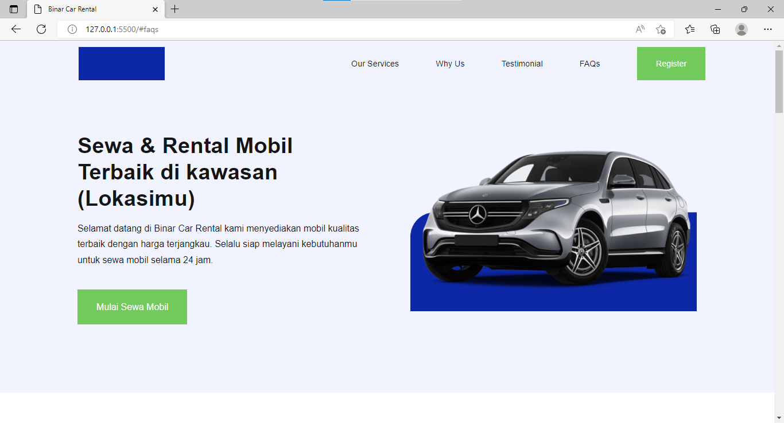
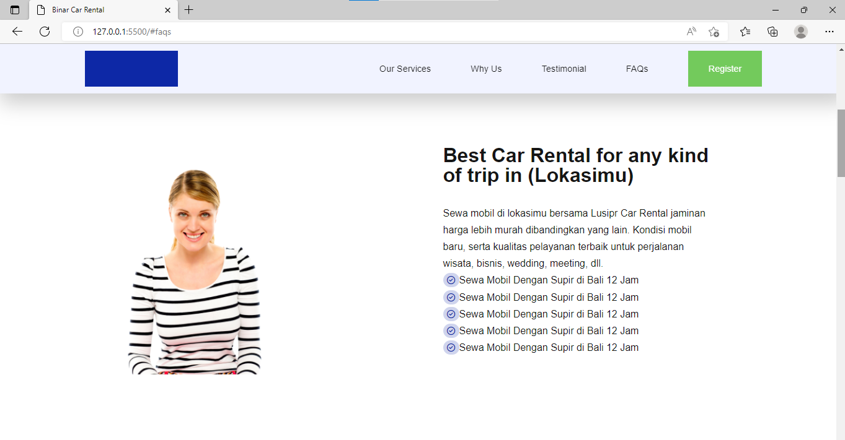
DESKTOP

Slide 4
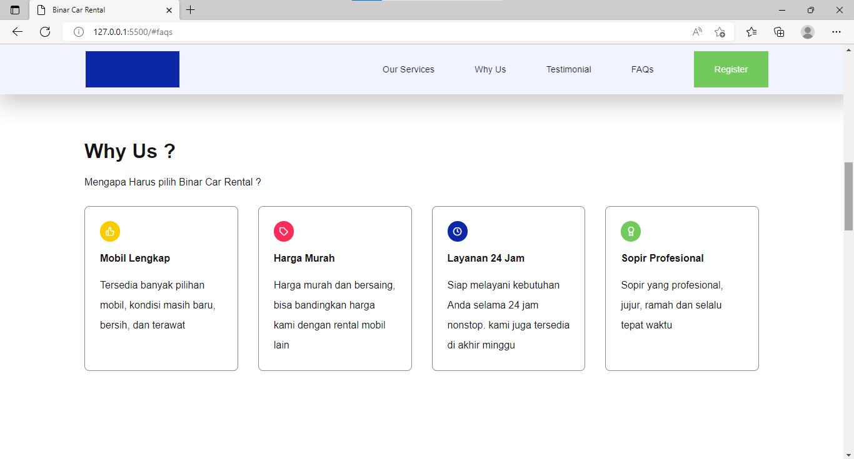
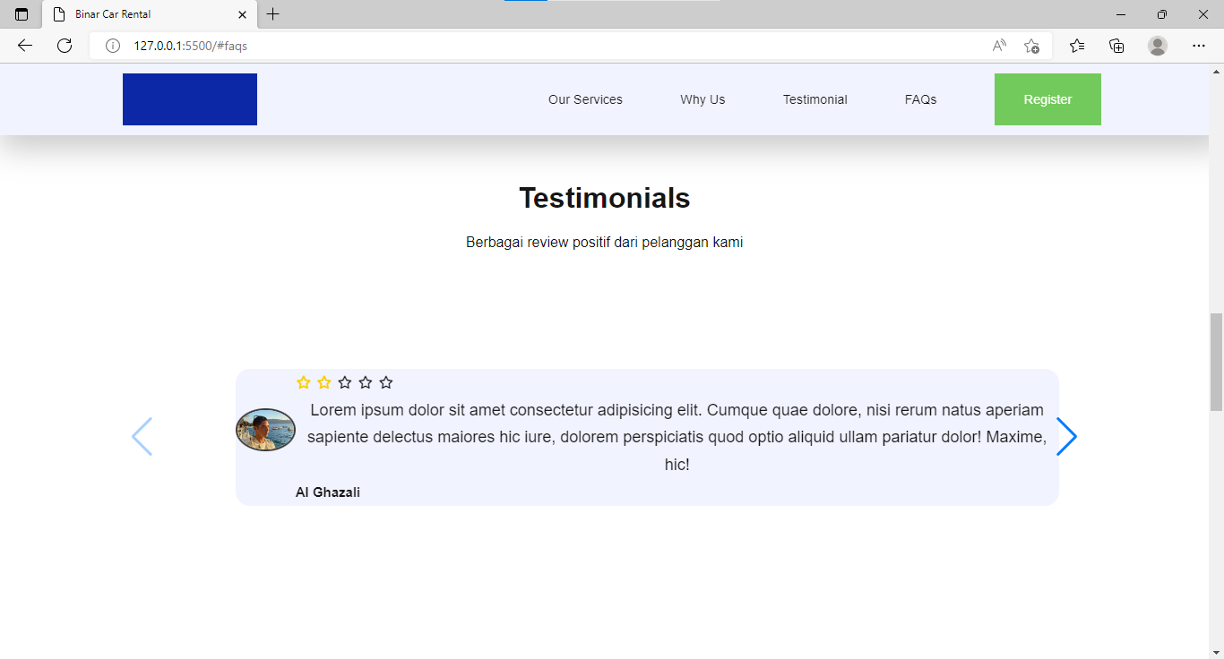
DESKTOP

Slide 5
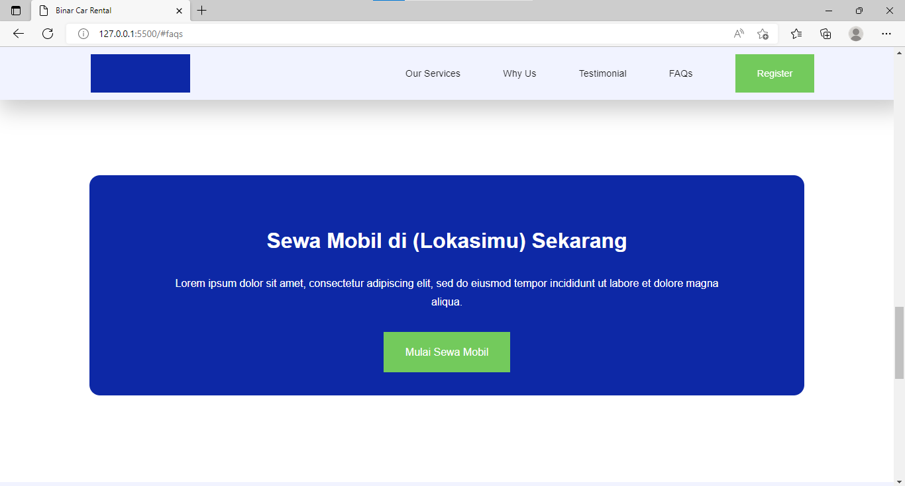
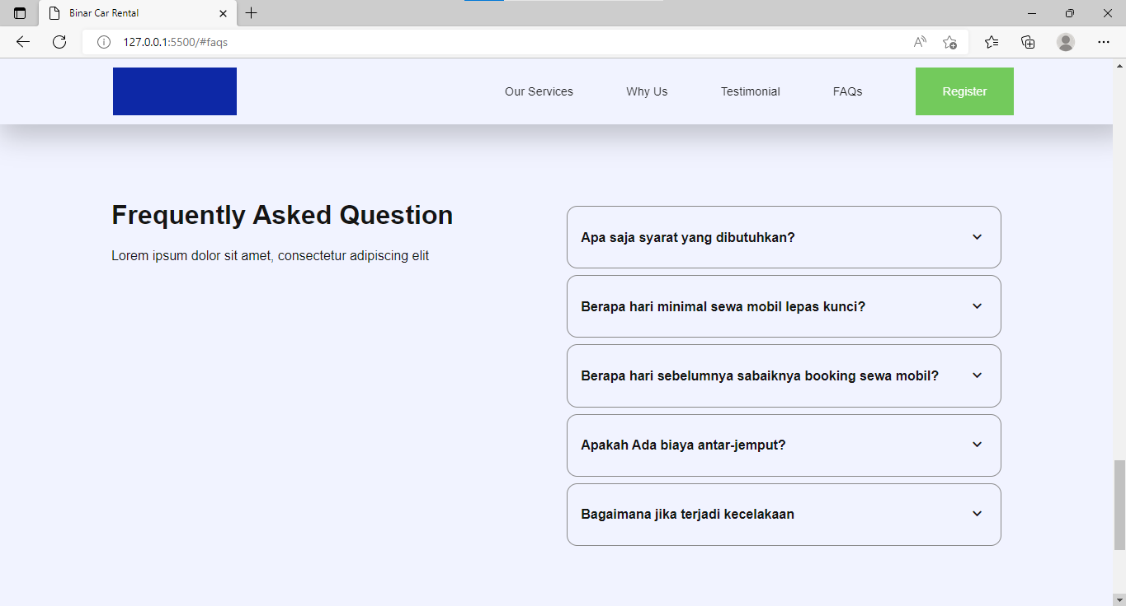
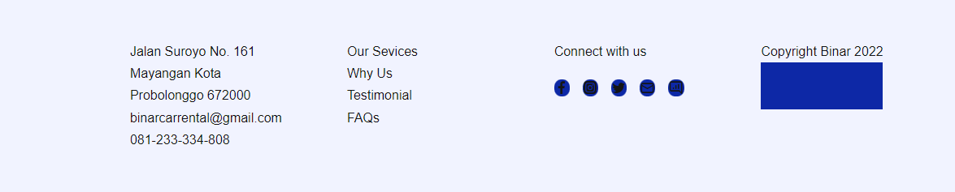
DESKTOP

Slide 6
MOBILE

Slide 7
Source Code
Link :
fuadydheo/Binar_ChallengeChapter1 at lusi-pri-hartini (github.com)

Slide 8
Thank
You

